Slide 1

IOWA
LIQUOR RETAIL

Slide 2
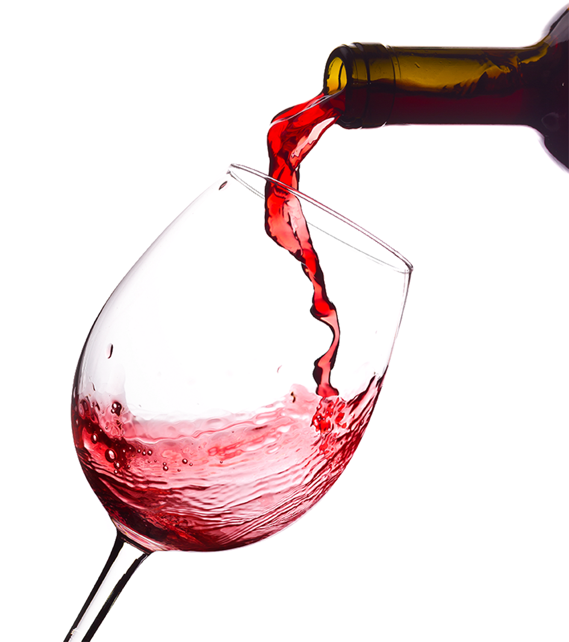

Design a landing strategy to enter IOWA Market maximizing revenue & reducing risk of failure.
OUR GOAL

Slide 3
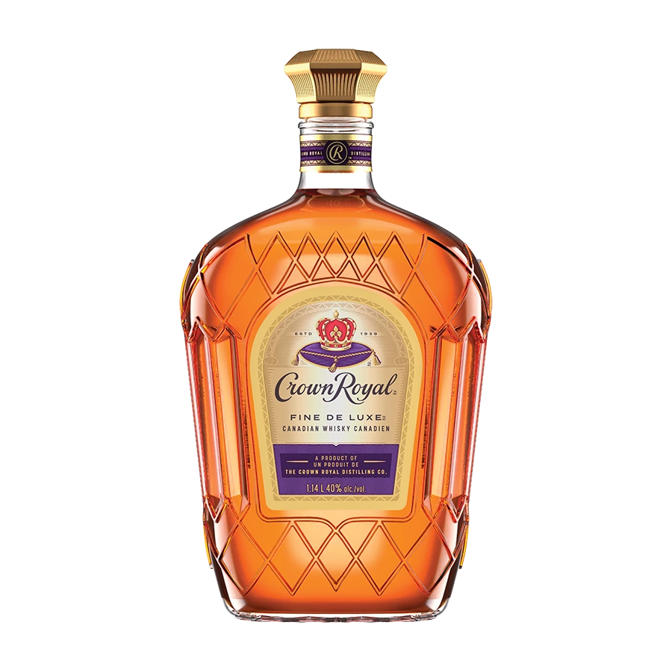
>$250 billion
Alcohol market value in 2023
U.S.A.

Slide 4
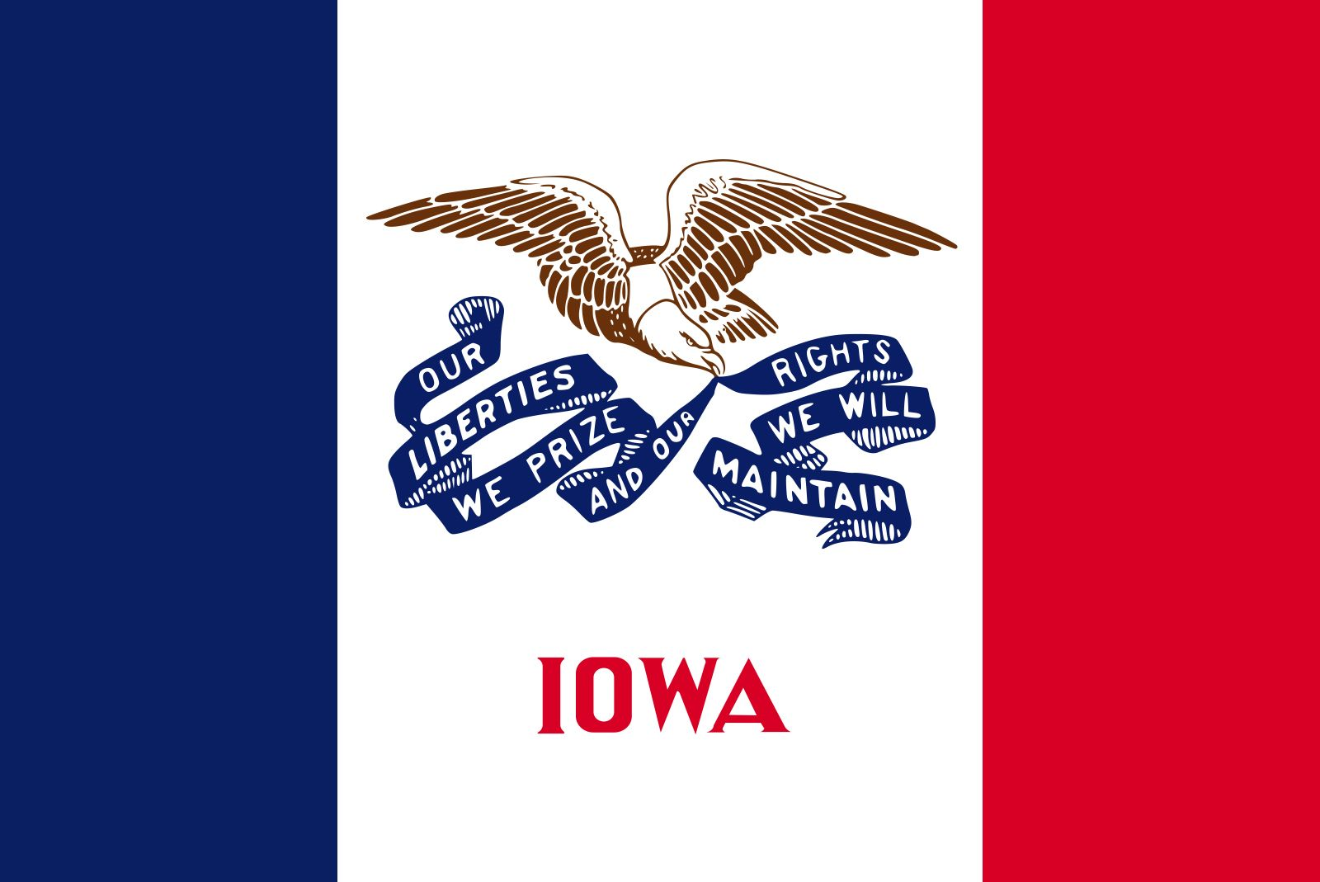
Why Iowa?
Cold climate → There is a direct relationship between reduced sunshine and cold weather and alcohol consumption
College and rural drinking culture
Approximately 65% of Iowa adults consume alcohol.
National average of 54%
Very detailed dataset

Slide 5
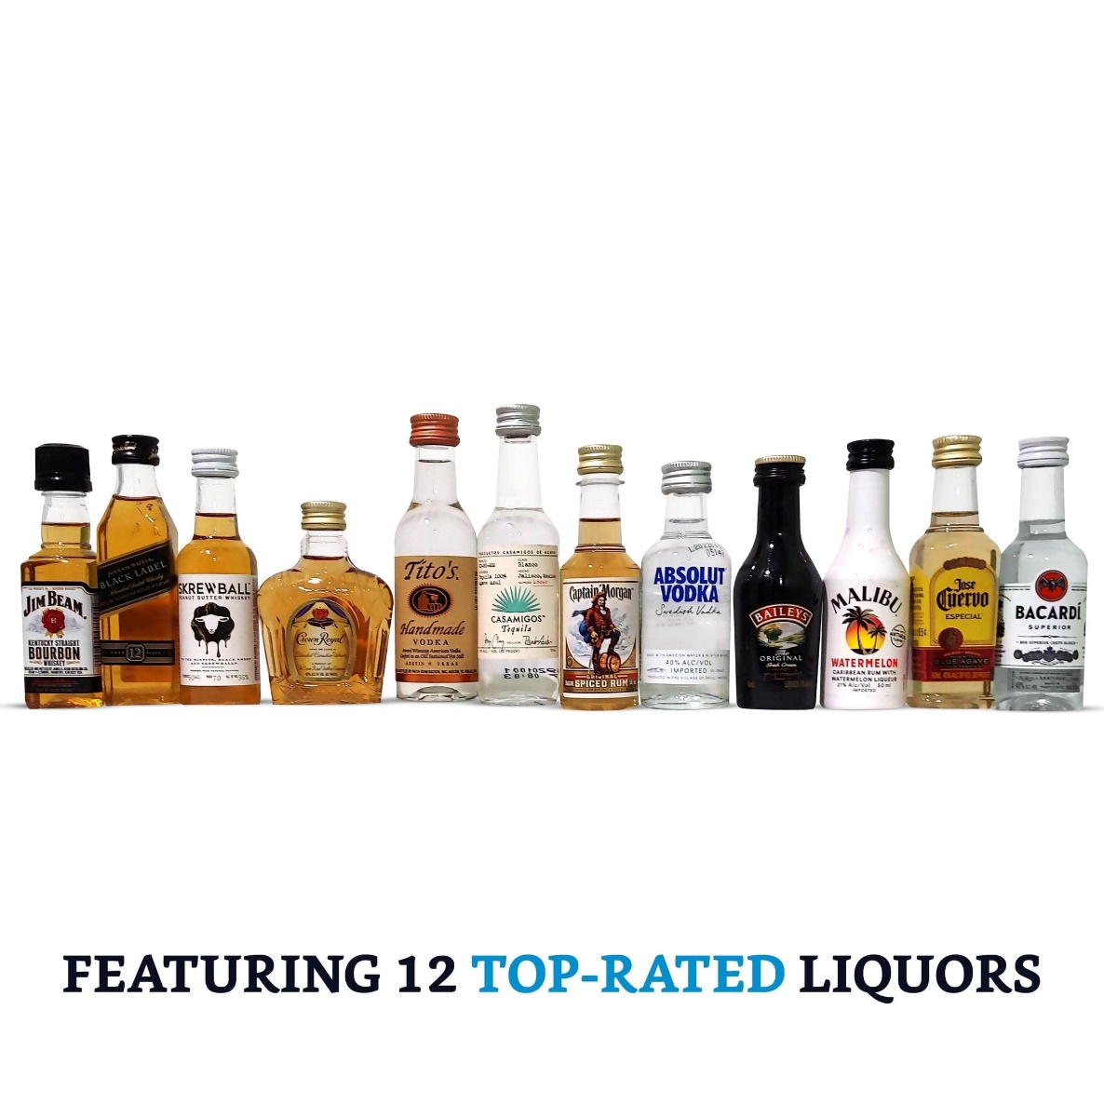

Iowans spent
$447 million
last year on liquor

Slide 6
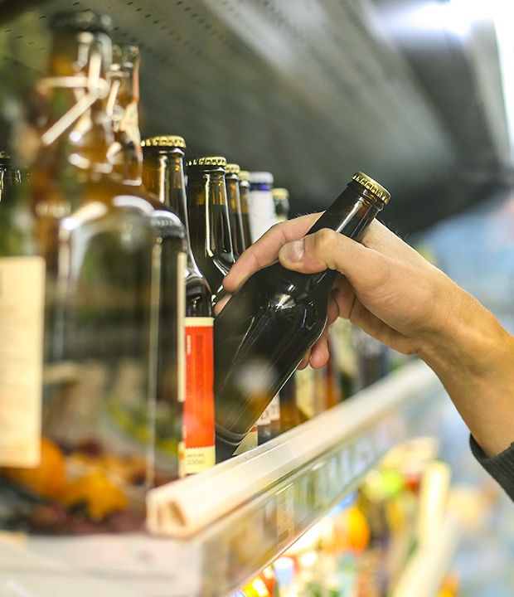
The Dataset
Spirits purchase transactional data from Iowa, USA (B2B).
Class “E” liquor licensees.¹
January 1st , 2012 to December 31st, 2024.
Over 30 million items to analyze.
1. Class ‘E’ license allows commercial establishments to sell liquor for off-premises consumption in original unopened containers.

Slide 7
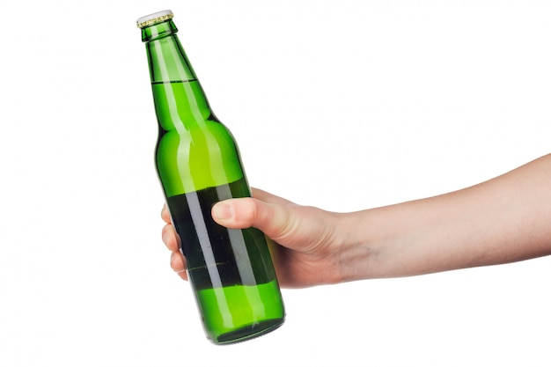
EDA Overview
Cleaning
Datetime format for index
Missing values imputed with external information & mean values
Standardized vendor & store names
Deleted redundant columns
New columns
Time variables
Season
National vs Imported
Type of alcohol
Type of store
Price category (Quality)
Format
Renaming columns for convenience

Slide 8
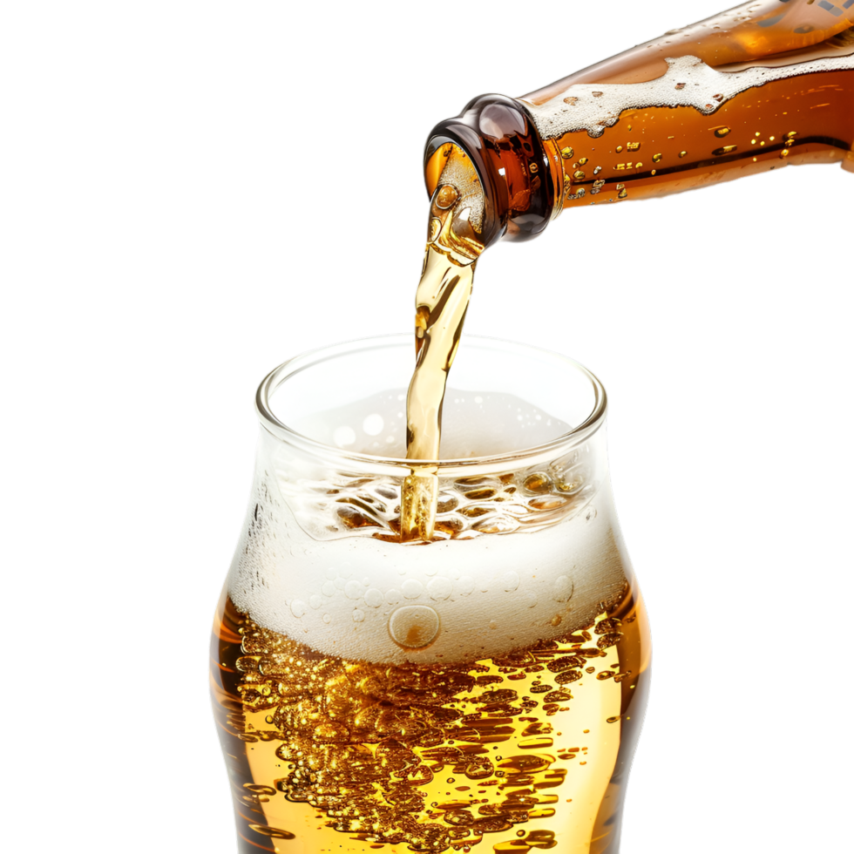
14
8
3
Types of Alcohols
Types of Stores
Price categories

Slide 9
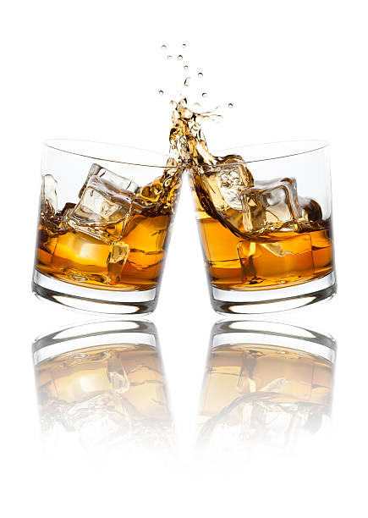
Types of Alcohols
Types of Stores
Price categories
Rum
Whiskey/Scotch/Bourbon/ Brandy
Vodka
Tequila
Mezcal
Spirits
Gin
RTD
Liquor
Schnapps
Giftset
Specialty Store
Grocery Store
Casino/Hotel/Amusement Park/Rest
Drug Store
Truckstop
Liquor store
Wholesale store
Convenience store
Mini Mart
Budget
Premium
Prestige
To review our price category ranges please navigate to Annex 1

Slide 10
All Time Overview
From 2012 until 2024
Notes:
Lets begin with a general overview of the whole data provided; from 2012 until 2024

Slide 11
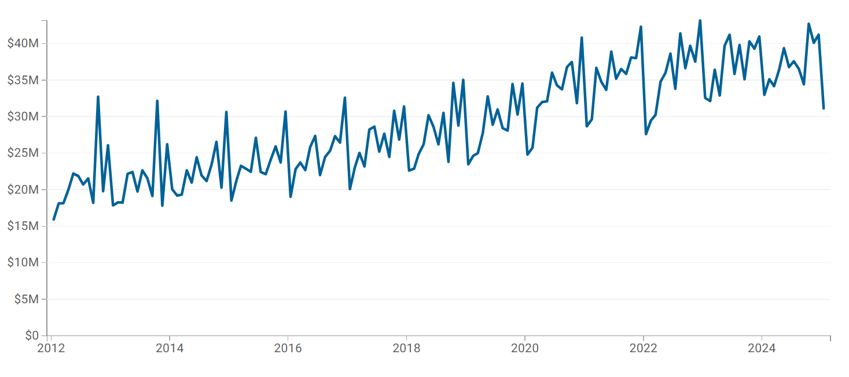
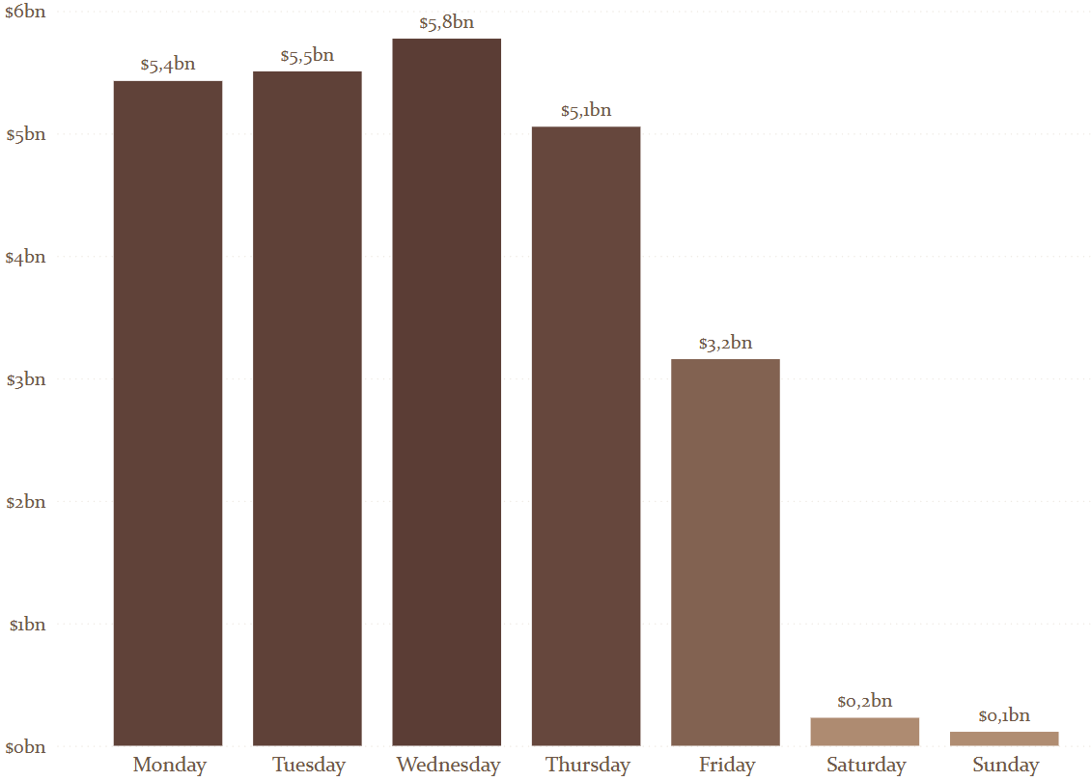
All Time Overview
Sales have increased over the years
Clear seasonality with peaks in October, March, December & lows in November & January.
https://data.iowa.gov/stories/s/mke2-7r5k
Notes:
Sales have increased year over year with clear peaks in march, oct and december; lows in november and january
Total sales Year over Year with monthly granularity
Holidays → Christmas & New Years // St. Patricks day (march)
Jan & Nov → usually people seek to be ‘healthier’ for the new year

Slide 12
All Time Overview
Weekday overview
Most sales are done during the week, with a peak on Wednesdays. On weekends sales go down.
Restocking to prepare for weekend demand and inventory turnover.

Slide 13
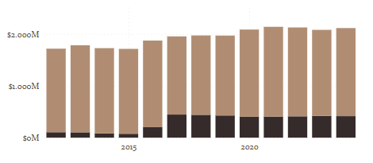
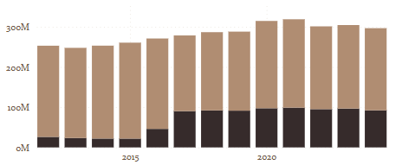
National vs Imported Alcohols
All Time Overview
Imported Alcohols outperform the sales in revenue and volume compared to American alcohols
Sales by
Revenue ($)
Sales by
Volume (Lt)
Imported
National

Slide 14
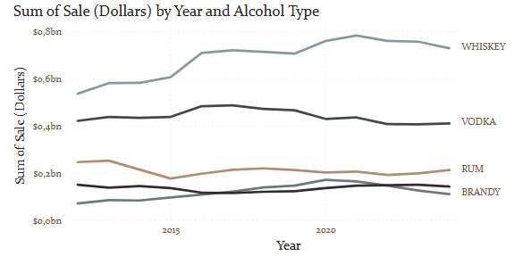
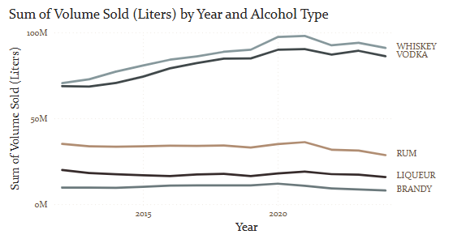
Most sold & consumed alcohols
All Time Overview
Whiskey's sales have historically outperformed other alcohol sales, however volume-wise Vodka's sales and Whiskey's have been tight, just slightly higher for whiskey
Sales by
Revenue ($)
Sales by
Volume (Lt)
91 M
$726k M
86 M
$408K M
Notes:
From an alcohol-type perspective, whiskey has historically outperformed all other alcohols in sales and consumption by volume; however volume wise vodka has been always tightly related to whiskey, as you can see in the graph

Slide 15
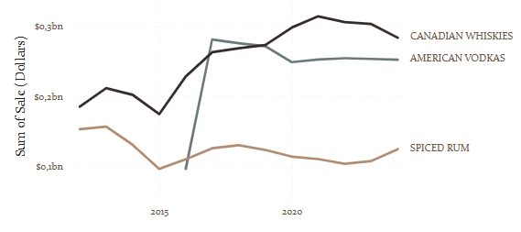
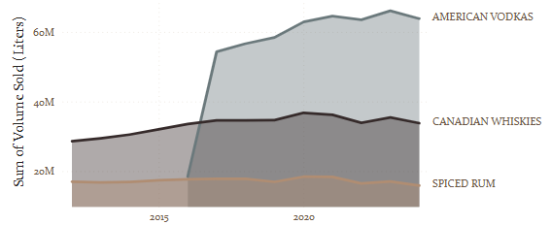
Top seller categories
All Time Overview
In terms of Sales’ Revenue ($), Canadian whiskies is the top-selling category all-time, with a slight downward trend in the last 4 years. However, American Vodkas have outperformed Canadian Whiskies in terms of sales volume (L).
Sales by
Revenue ($)
Sales by
Volume (Lt)
64M
34M
30M More Liters of American Vodkas were sold in 2024, compared to Canadian whiskies.
Notes:
On the other hand, by analyzing top-sellers by category name, we can see that canadian whiskies are the top seller category by revenue, followed by american vodkas; however, thats not the case for sales by volume, where american vodkas almost double their sales compared to canadian whiskies. 30M more liters sold in 2024 of american vodkas sold compared to canadian whiskies.

Slide 16
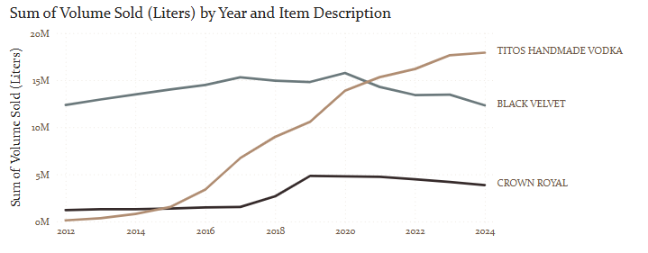
Top 3 Items
All Time Overview
In terms of consumer preference, Tito’s Handmade Vodka is the top choice all-time, with trend going upwards, while its historical competitors are slowly decaying.
Sales by
Volume (Lt)
Do consumers behave the same as they did 13 years ago?

Slide 17
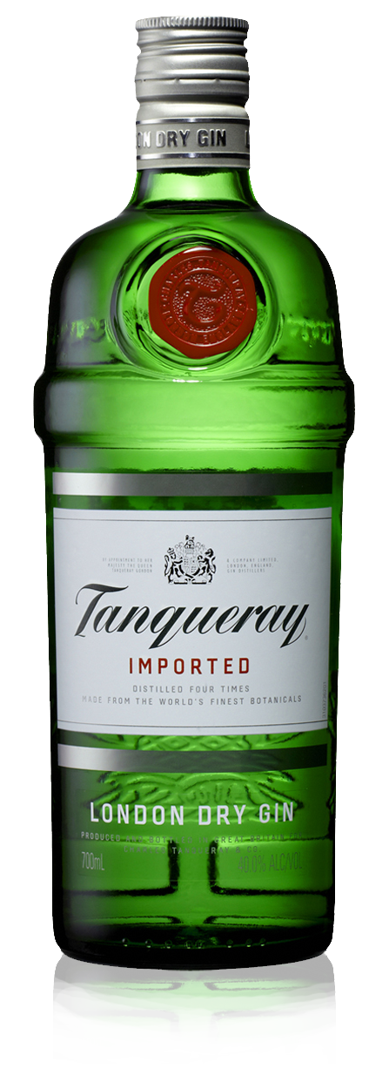
2021 onwards analysis
Notes:
Customer behavior is constantly changing, so we Will analyze 2021 onwards

Slide 18
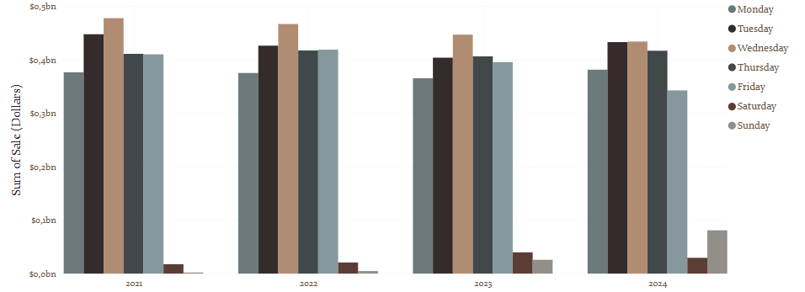
Post-covid overview
Weekday overview
Through out the years, behavior of purchases per day of week has remained the same.
Sales by
Revenue ($)
Wednesday
https://notify-me.io/post/optimal-timing-for-restocking-products?form=MG0AV3

Slide 19
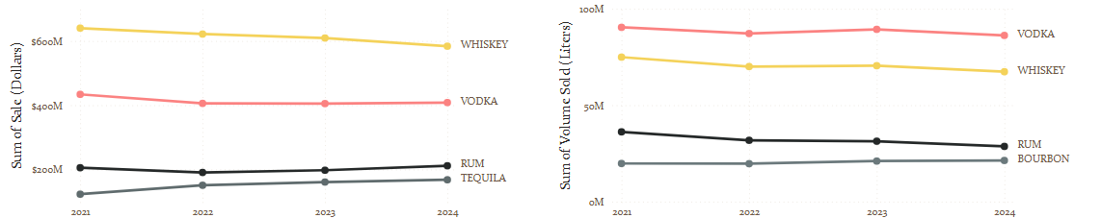
Most sold & consumed alcohols
Post-covid Overview
Whiskey's sales ($726M) have historically outperformed other alcohol sales, however volume-wise Vodka's sales and Whiskey's have been tight, just slightly higher for whiskey (91M L)
Sales by
Revenue ($)
Sales by
Volume (Lt)
91 M
$786 M
86 M
Notes:
Conclusion: vodka as an alcohol type

Slide 20
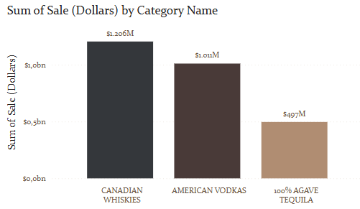
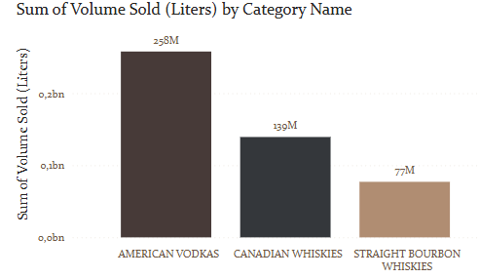
Top 3 Categories Sales
Post-covid overview
In terms of revenue, Canadian Whiskies have brought the most money to the table; however, American Vodkas account for the double number of liters sold of Canadian whiskies
Sales by
Revenue ($)
Sales by
Volume (Lt)

Slide 21
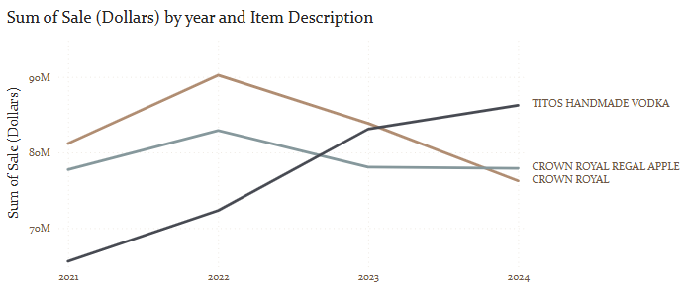
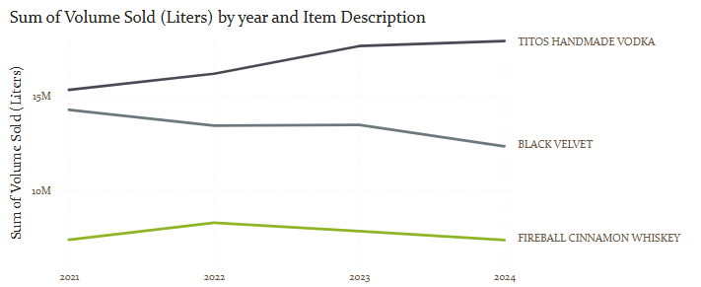
Top 3 Items
Post-covid overview
Sales by
Revenue ($)
$86,3 M
In terms of both, sales in USD and liters, Tito’s Handmade Vodka is the #1 top alcohol sold in IOWA.
Two new players come into the scene when we compare the most sold items by volume: Black Velvet and Fireball cinnamon whiskey is what is most sold in terms of volume.
Sales by
Volume (Lt)
18 M
12,3 M

Slide 22
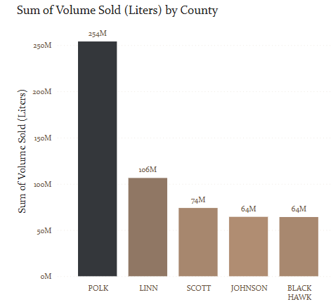

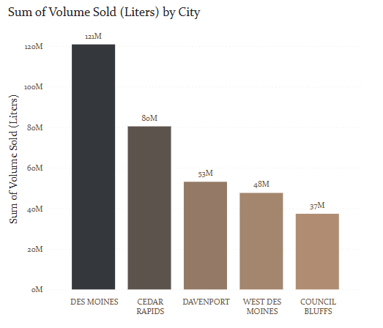
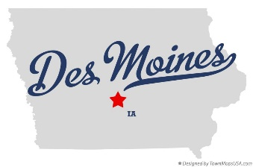
Post-covid overview
County & City with most sales
The highest selling location in Iowa is Des Moines, Polk.
County
City

Slide 23
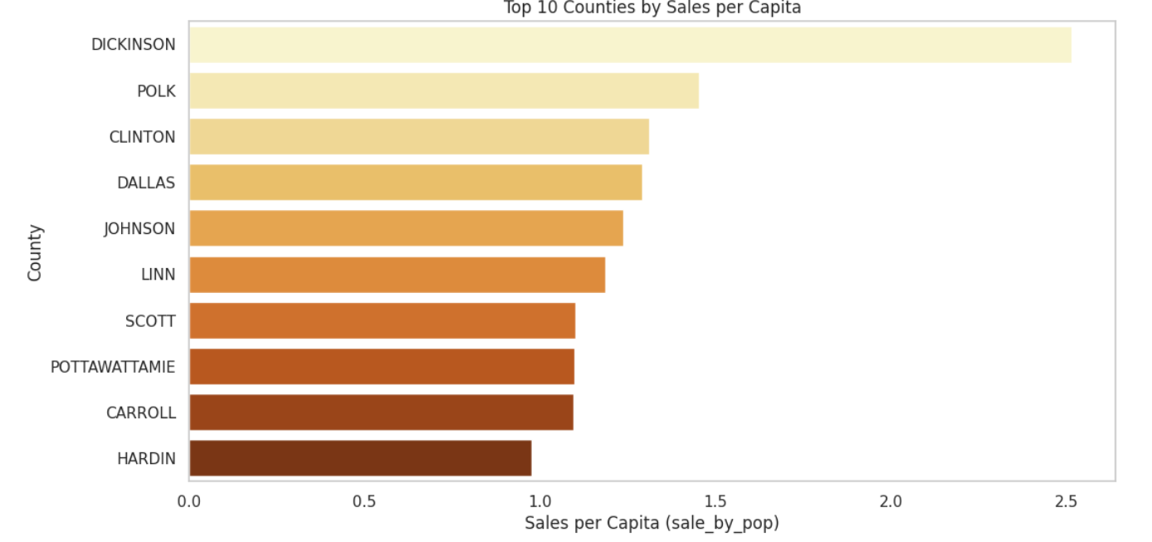
Post-covid overview
Sales per capita
Polk is the 2nd county with most liters' consumption per capita.
Top 10 Counties by Sales per Capita
County
Sales per Capita

Slide 24
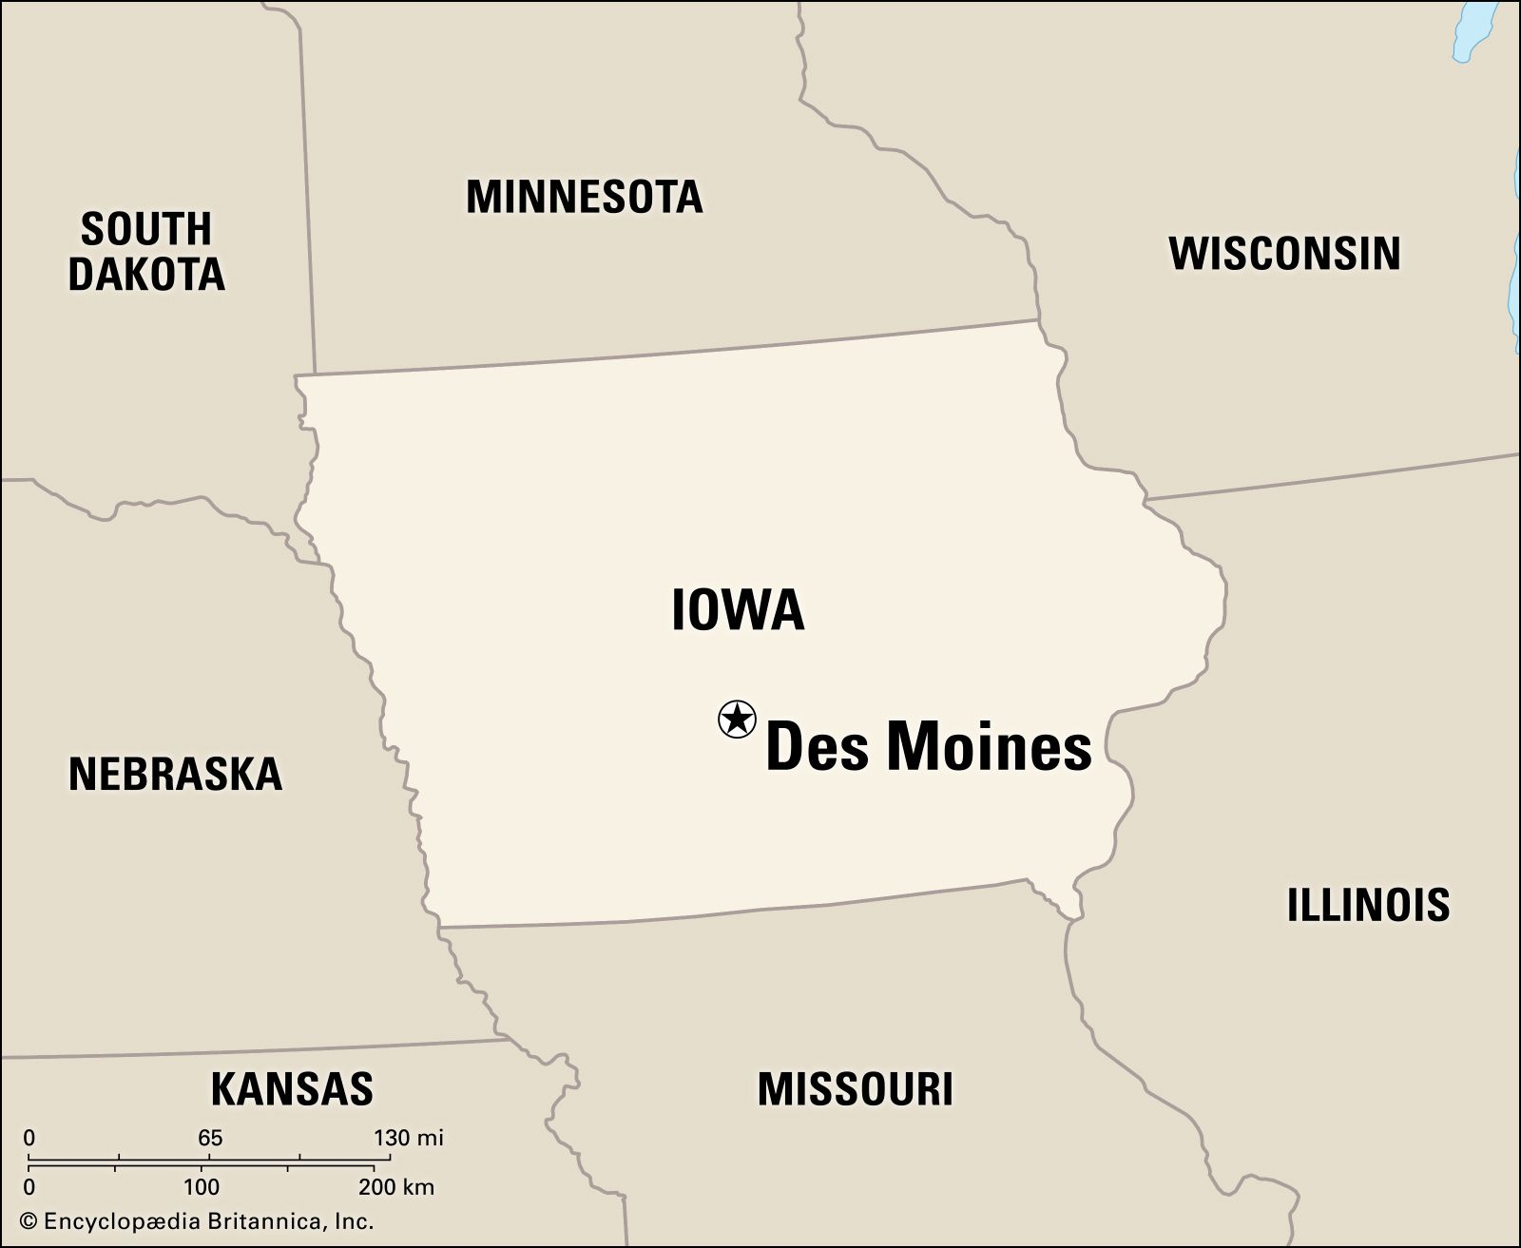
Post-covid overview
Why Des Moines, Polk?
Polk County
Most populous & urbanized county in Iowa
Affluent population ($) compared to the rest of the counties which are more rural:
Higher Median household income $78,827 (2022)
Homeownership rate: 67.1% (2022)
Des Moines – Capital city:
White: 79,4%
Hispanic: 7,57%
Black: 5,44%
Polk County, IA | Data USA
Notes:
Affluent population compared to the rest of the counties which are more rural:
95% of the population lives in urban areas
505k residents as of 2025)

Slide 25
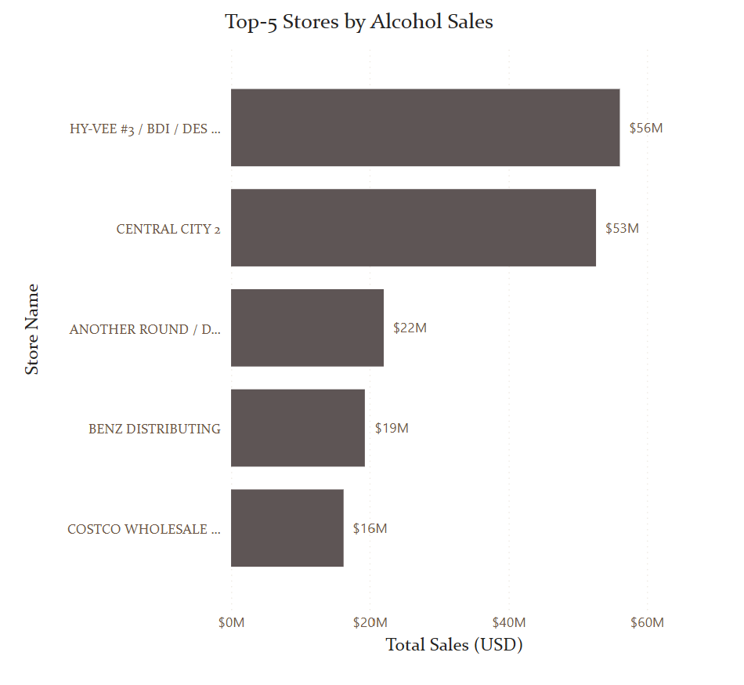
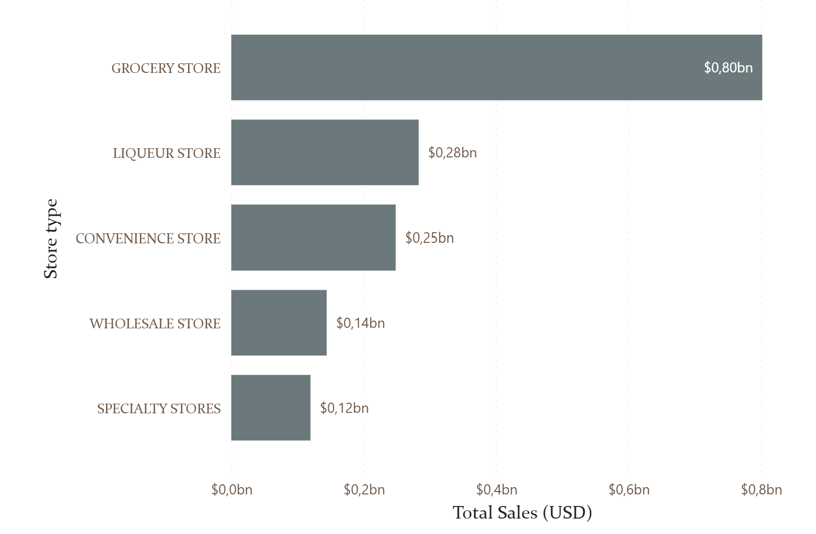
Post-covid overview
Stores with most sales
Store
Type
Store
Name

Slide 26
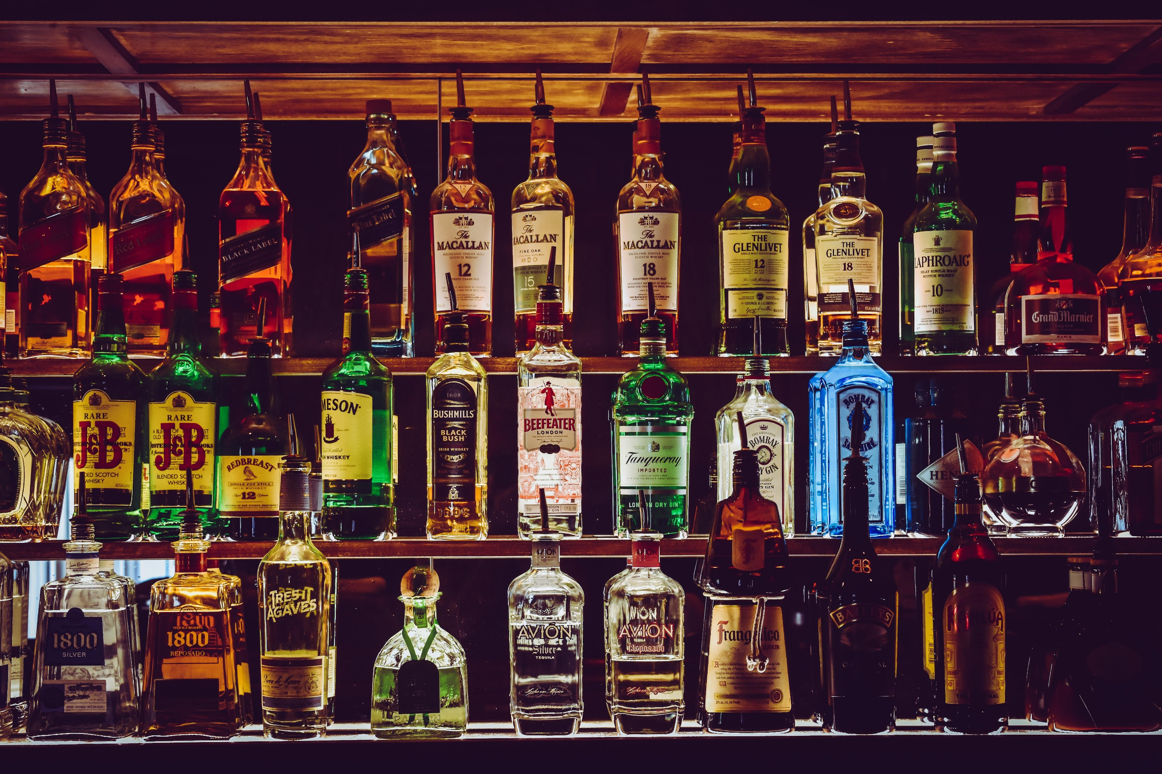
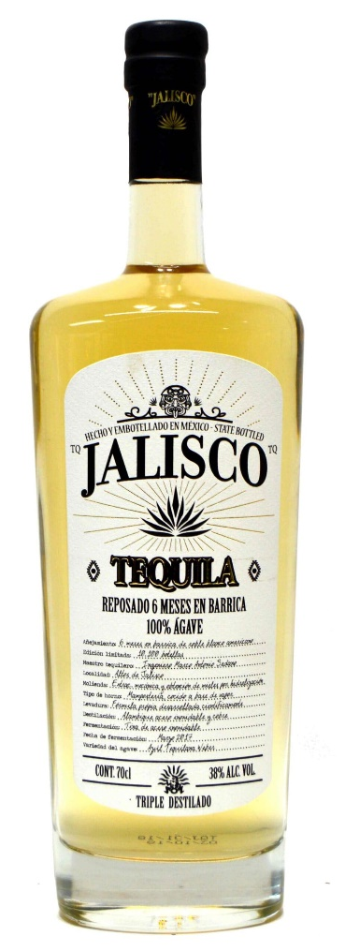
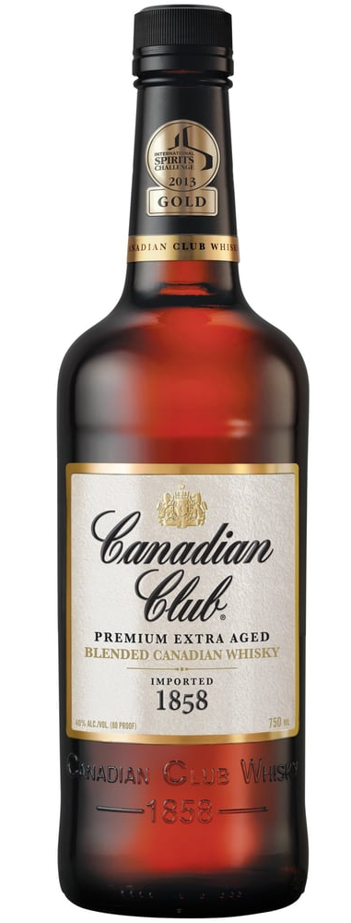
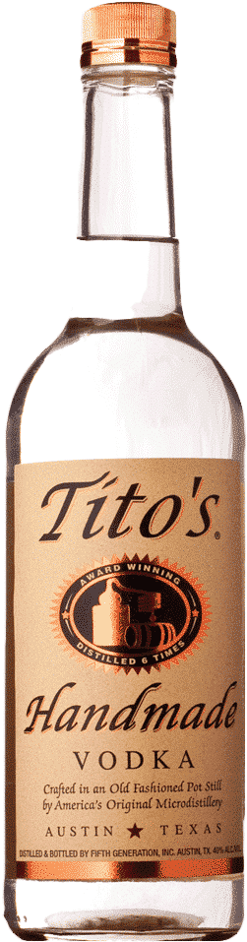
?
Transition slide to introduce the 3 scenarios.
Whiskey
Vodka
Tequila
Notes:
But this is a lot of data; and we hav to narrw down to still answer the question… which category should we enter IOWA with? Well our scientific knowledge and market experiences drove us to have 3 possible scenarios.

Slide 27
Three scenarios
Whiskey
Vodka
Tequila
Whiskey

Slide 28
Whiskey
Distilled alcoholic beverage made from fermented grain mash, aged in wooden casks.
Notes:
All-time best seller ($) as an alcohol type and for categories; it’s a

Slide 29
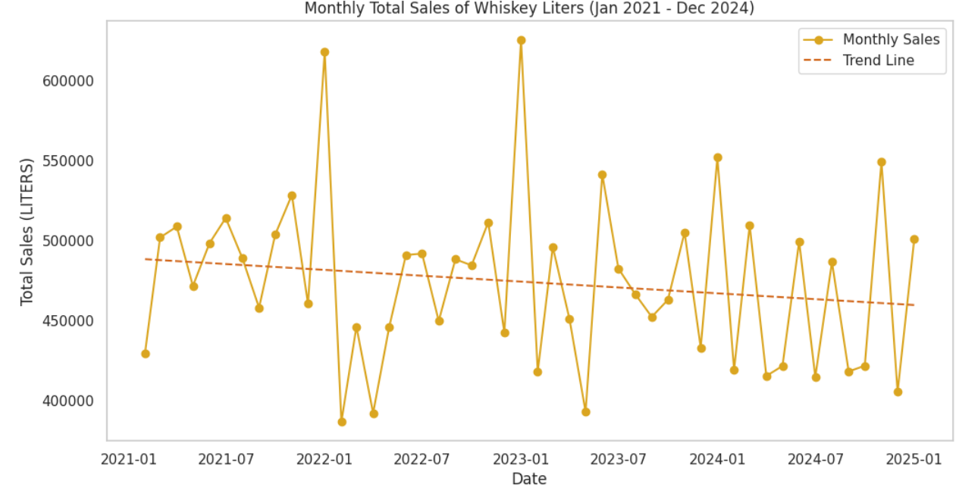
Post-covid overview
Whiskey sales are decreasing.
Although it’s an all-time best seller the trend says it will keep decaying. Reflecting a bad investment now.
Sales by
Volume (Lt)
Vodka
Notes:
Iowa’s capital

Slide 30
Vodka
Distilled beverage made from water and diluted ethyl alcohol, or ethanol made by fermenting cereal grains and potatoes.
Notes:
Today, I’m excited to present the vodka category, which holds a unique position in the alcohol market in Iowa.

Slide 31
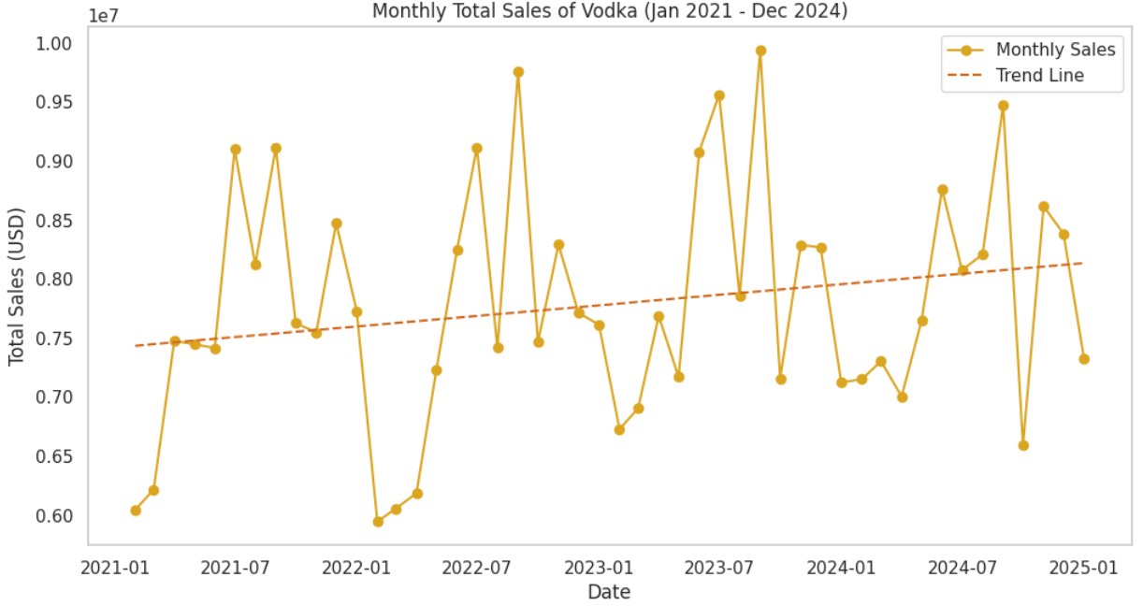
Vodka Analysis
Total Sales
Vodka is the 2nd most sold alcohol type overall.
Sales by
USD
Notes:
Vodka is the second most sold alcohol in Iowa, which shows the strong demand for this spirit. What’s even more interesting is that the trend for vodka is slowly growing, suggesting that its popularity has been steadily increasing over the years.

Slide 32
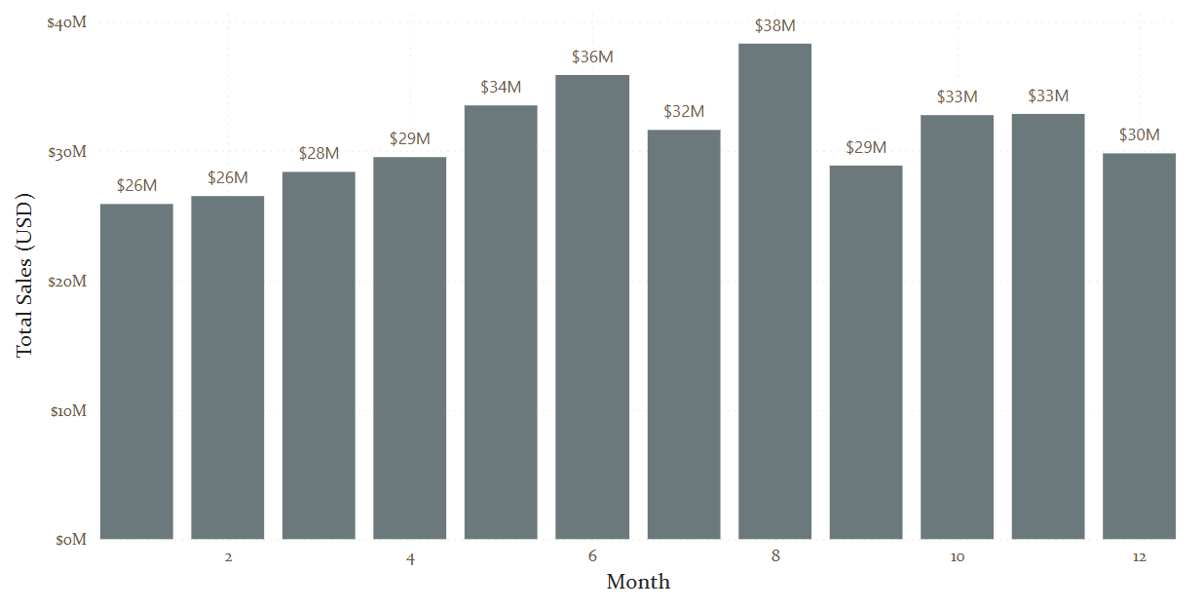
Vodka Analysis
Total Sales by Month
Highest sales on May, June & August.
Sales by
Revenue ($)
Notes:
Now, let’s talk about sales trends. Vodka sales experience a clear seasonal fluctuation throughout the year. The highest sales are typically recorded in May, June, and August, which are the peak months of the summer. This aligns with the way people enjoy vodka, often in outdoor social settings, summer parties, and barbecues. During these warmer months, there’s a notable increase in demand as people gravitate toward refreshing cocktails and cooler drink

Slide 33
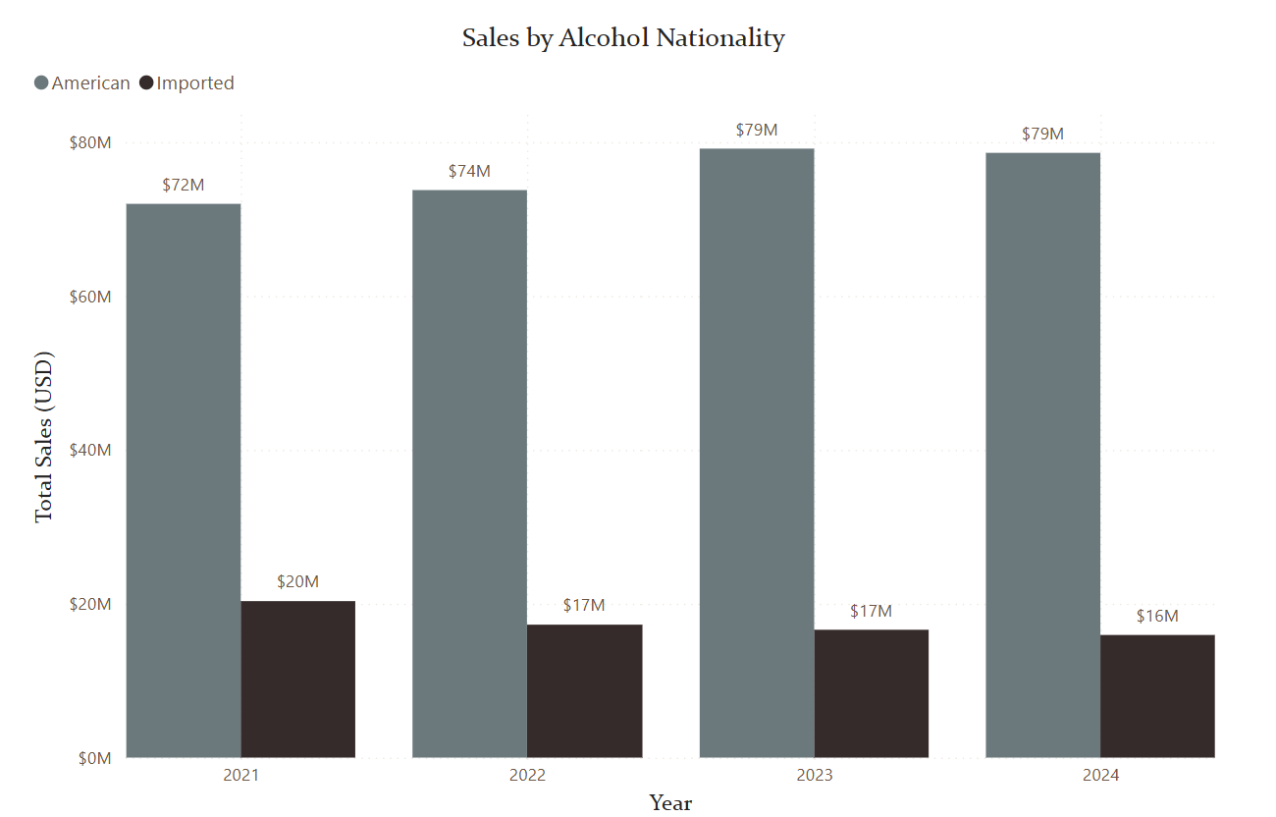
Vodka Analysis
American vs Imported Vodkas
Historical data shows higher consumption of imported alcohol, while the Vodka category exhibits the opposite trend.
Notes:
When we take a look at the historical data for overall alcohol consumption, we see a fascinating pattern. Typically, imported alcohol dominates the market in Iowa, but when it comes to vodka, we actually see the opposite trend. Domestic vodka is more popular, and it’s been gaining momentum.

Slide 34
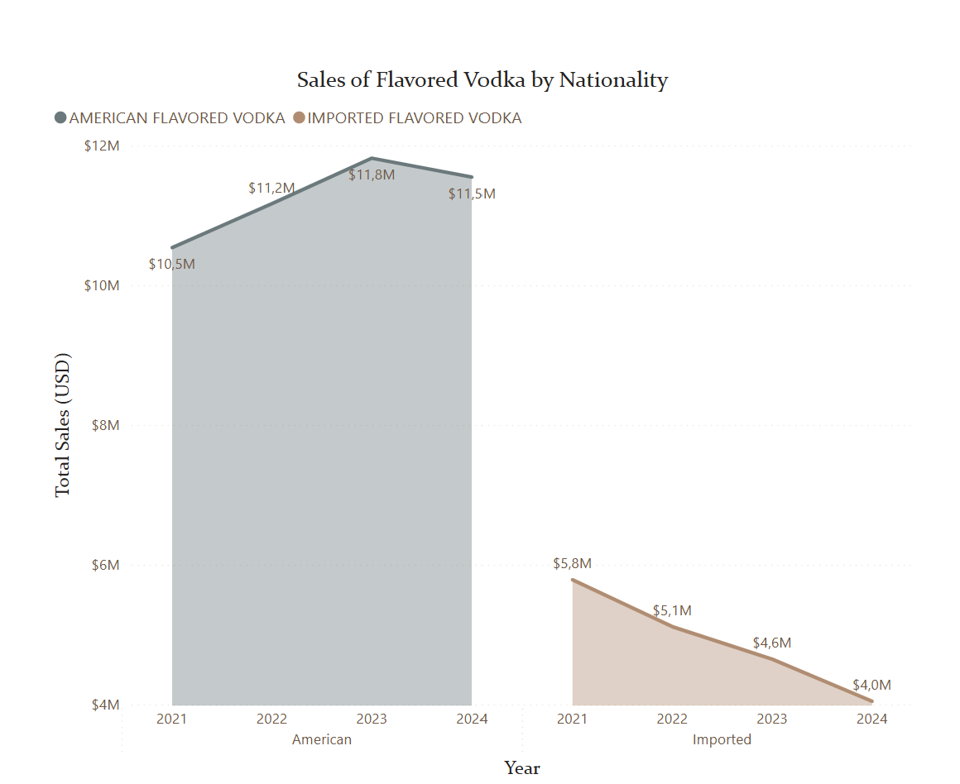
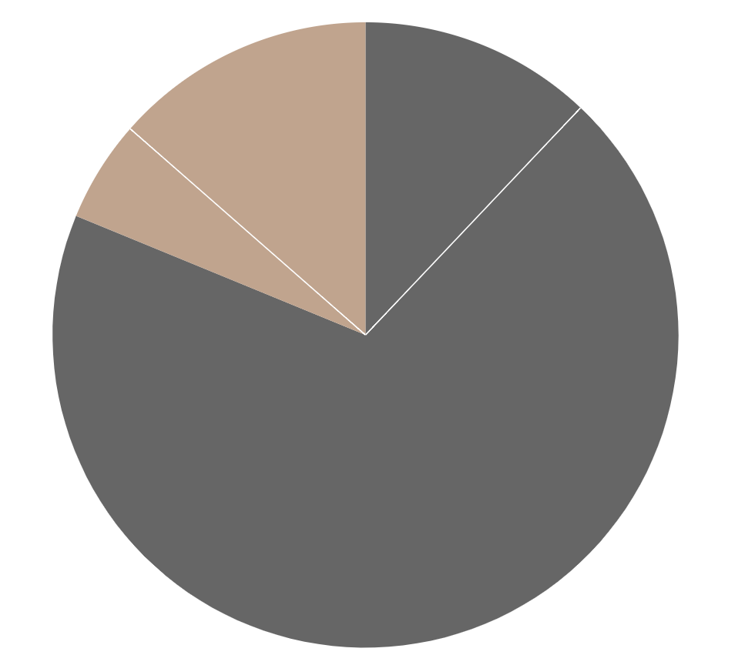
Vodka Analysis
Flavored or flavorless Vodka?
We can observe that flavored vodka is less popular compared to regular vodka, and the trend for flavored vodka is declining further.
Flavored Vodka
25.49%
Not- Flavored Vodka
74,51%
Notes:
Flavored vodka appears to be less popular than regular vodka, with the trend for flavored varieties continuing to decline.

Slide 35
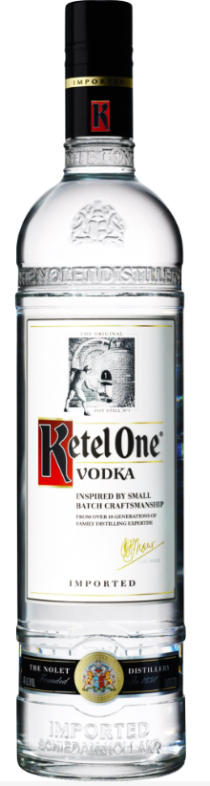
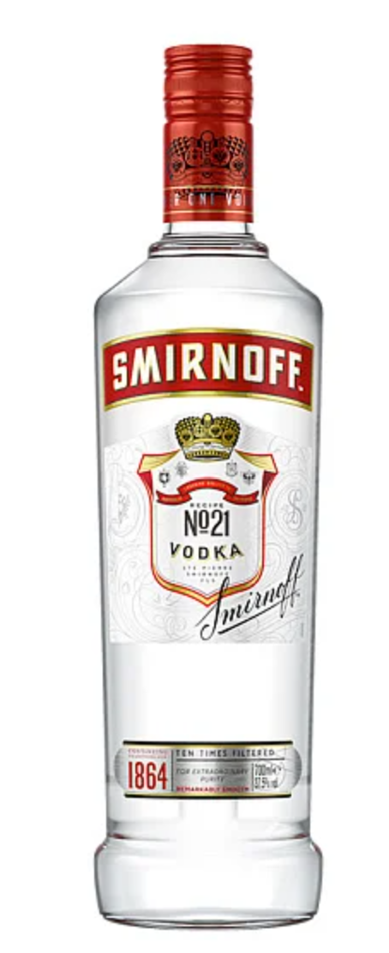
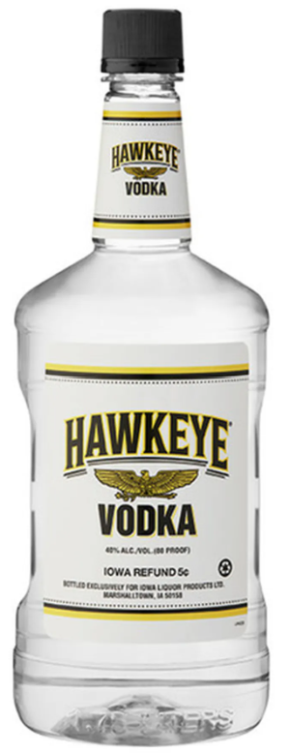
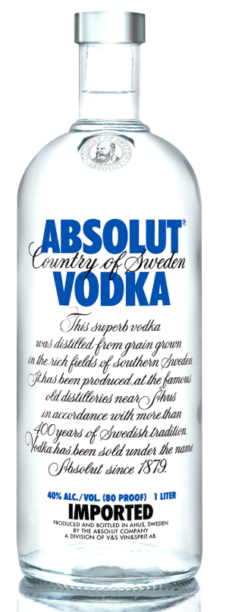
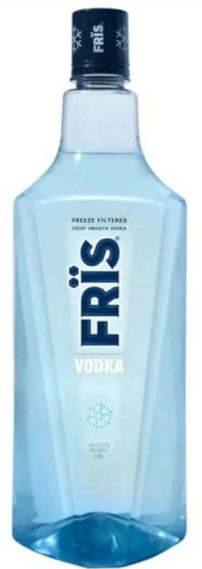
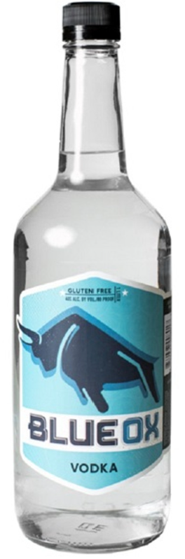
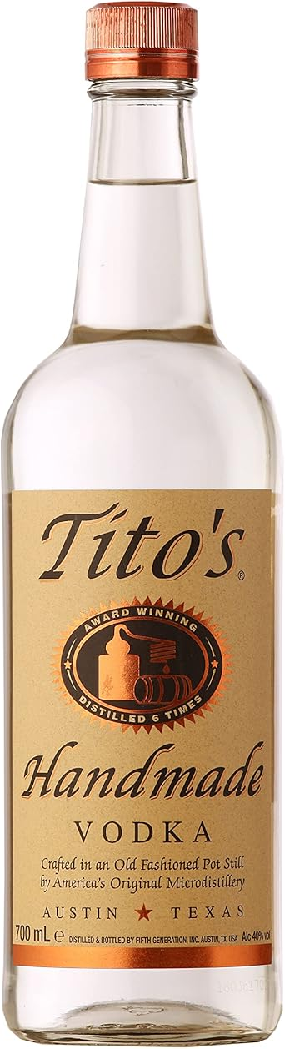
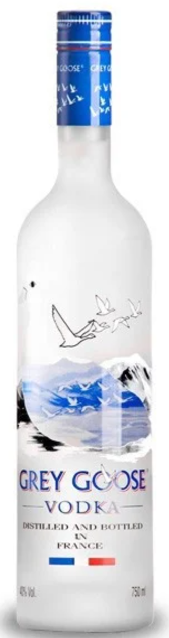
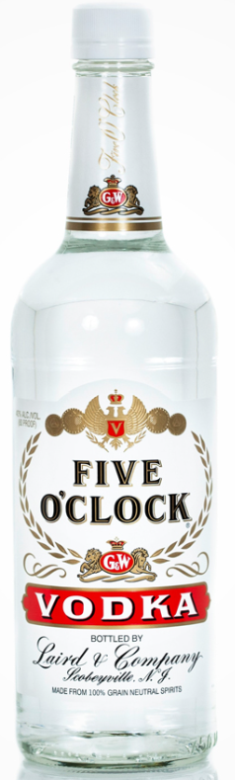

Vodka Analysis
Top 10 selling vodkas
1
10
Notes:
Titos handmade vodka (American vodka )
Smirnoff (American vodka)
Hawkey vodka (American vodka )
Absolut Swedish Vodka (Imported vodka)
Grey Goose (Imported vodka)
Mccormic 80PRF (American vodka)
Frish Danish Vodka (Imported vodka)
Blue OX Vodka (American vodka)
Five O'clock (American Vodka)
Ketel one (Imported vodka)

Slide 36
Vodka Analysis
Top 10 selling vodka
Imported Vodka
American

Slide 37

Vodka Analysis
American Vodka
A slight increasing trend in American vodka sales can be observed.
Sales by
USD
Notes:
After reviewing all the categories, the best opportunity to penetrate the market lies in the growing trend of American vodka sales, which have shown a slight but steady increase.

Slide 38


Vodka Analysis
Where is Vodka bought
County
American Vodka
Notes:
Additionally, it’s worth noting that Polk County leads the state with the highest sales in vodka, making it a key area to target for further market expansion.

Slide 39

Vodka Analysis
Where is Vodka bought?

Slide 40


Vodka Analysis
Which stores sell the most?
SSales by les by
Revenue ($)
SSales by les by
Revenue ($)
All Vodka
American

Slide 41



Vodka Analysis
Top Vodka Vendors (competitors)
Sales by
Revenue ($)
Sales by
Revenue ($)
Fifth Generation Inc. 26.52%
Diageo Americas 23,82%.
Fifth Generation Inc. 37,56%
Pernod Ricard USA. 17,42%
Sazerac Company inc. 14,41%.
Diageo Americas 33,05%.
Sazerac Company inc. 13,29%.
Luxco Inc 13,12%.
Luxco Inc 9,71%.
McCormick Distilling. Co. 11,08%.
All Vodka
American Vodkas

Slide 42

Who drinks it?
Vodka Analysis
The next two age groups are 35-44 and 45-54 drink at the same level.
19.3%
18.3%
18.3%
Share of vodka drinkers
Years of age
1. 2024, USA.
https://www.statista.com/statistics/1557077/vodka-drinkers-by-age-us/
Notes:
The next two age groups are35-44 and 45-54 have the same level of consumption

Slide 43

Vodka Analysis
Who drinks it?
Demographics
The USA is the 2nd largest country in the world for vodka consumption by volume.
Consumers aged 25 to 34 represent the largest share of vodka drinkers¹
The next two age groups are 35-44 and 45-54 drink at the same level
1. 2018, USA.
https://distiller.com/articles/vodka-basics#:~:text=According%20to%20the%20Distilled%20Spirits%20Council%2C%20vodka%20sales,volume%20%2876.9%20million%209-liter%20cases%20sold%29%20in%202022.
https://www.statista.com/statistics/1557077/vodka-drinkers-by-age-us/
https://www-statista-com.ie.idm.oclc.org/statistics/1022306/iowa-population-share-age-group/
Notes:
The next two age groups are35-44 and 45-54 have the same level of consumption

Slide 44

Vodka Analysis
Pack & ML
According to the data, the most popular
presentations by bottles sold:
Bottle of 1750 ML
Pack of 12 bottles

Slide 45

Vodka Analysis
Price for Vodka
In Liters, reflecting consumption, Iowans prefer budget & prestige Vodkas.
Sales by
Volume (Lt)
Premium
$20-$50 USD
Budget
<$20 USD

Slide 46


Vodka Analysis
Vodka brief
WHAT
American Vodka
HOW
Bottles of 1750ML & Packs of 12bottles
Between $10 & $20 USD
WHEN
Launching event in the begining of May to be positioned on Memorial day(last Monday of May) and start of Summer.
WHERE
Grocery & Convenience stores
Des Moines, Polk
-
Tequila

Slide 47
Tequila
Distilled beverage made from the blue agave plant, primarily around Tequila, Jalisco. ¹
1. Tequila has a protected designation of origin to be manufactured in Tequila, Jalisco, Mexico.

Slide 48

Tequila Analysis
Total Sales
Tequila is the 3rd most sold alcohol type overall with an optimistic upward trend. .
Sales by
USD

Slide 49

Tequila Analysis
Total Sales by Month
Highest sales on June, August & December.

Slide 50

Tequila Analysis
Tequila categories
Tequila
Mixto Tequila
100% Tequila
Between 51%
and 100% agave
Imported from
Mexico

Slide 51


Tequila Analysis
Tequila 100% Agave is a rising star
Rising stars—alcohol types with the largest sales growth from the first to the last year in the dataset.
4th
Most sold category
by USD.
Steady sales =
safeness of investment
Notes:
Although Mixto Tequila is not increasing, it shows steady behavior through the previous years showing safeness in the investment.

Slide 52
Tequila types
Tequila Analysis
Blanco
Reposado
Añejo
Rosado
Dorado/Joven
Flavored

Slide 53

Blanco tequila leads sales
Reposado also has an upward tend.

Slide 54










Tequila Analysis
Top 10 selling tequila
1
10

Slide 55







Tequila Analysis
Top 10 selling tequila
Blanco Tequila
Reposado Tequila
Añejo Tequila
All Tequila

Slide 56

Tequila Analysis
Where is Tequila bought
County
All Tequila & Blanco Tequila

Slide 57


Tequila Analysis
Where is Tequila bought?
Type of Store
Sales by
Revenue ($)
Sales by
Revenue ($)
All Tequila
Blanco
Notes:
Blanco tequila is more sold in convenience stores than wholesale, compared to all tequila

Slide 58





Tequila Analysis
Top Selling Stores
Store level
Sales by
Revenue ($)
Sales by
Revenue ($)
All Tequila
Blanco

Slide 59

Tequila Analysis
Pack & ML
According to the data, the most popular presentations by bottles sold:
BOTTLE OF
750 ML
PACK OF
12 BOTTLES

Slide 60



Tequila Analysis
Top Tequila Vendors (competitors)
Sales by
Revenue ($)
Sales by
Revenue ($)
Proximo 21.77%
Sazerac Company inc. 11,82%.
Mast-Jagermeister 24,83%.
Mast-Jagermeister 8,52%.
Bacardi 10,21%.
MPL Brands NV Inc 1,65%.
Sazerac Company Inc. 6,31%.
All Tequila
Blanco

Slide 61

Tequila Analysis
Price for Tequila
In Liters, reflecting consumption, Iowans prefer premium & prestige Tequilas.
Sales by
Volume (Lt)
Prestige
>$40 USD
Premium
$15-$40 USD

Slide 62

Tequila Analysis
Who drinks it?
Demographics
Consumers aged 25 to 34 represent the largest share of tequila drinkers¹
Second largest group is 35 to 44
More females than males drink Tequila
1. 2023, USA.
https://www.resonate.com/blog/which-states-have-the-most-tequila-drinkers-nationwide/#:~:text=Demographically%20speaking%2C%20women%20are%20more,in%20the%20past%20three%20months.
https://www.statista.com/statistics/1349936/tequila-consumers-by-age-us/#:~:text=Consumers%20aged%2025%20to%2034,share%20at%20just%204.7%20percent
https://www-statista-com.ie.idm.oclc.org/statistics/1022306/iowa-population-share-age-group/

Slide 63

Tequila Analysis
Who drinks it?
Iowa’s two largest population group is aligned with highest Tequila consumers nationwide.
12.8%
12.4%

Slide 64

Tequila Analysis
Tequila brief
WHAT
Blanco Tequila, 100% Agave
HOW
Bottles of 750ML & Packs of 12bottles
WHEN
Launching event on 5 de Mayo.
Positioned by June (highest sale month) & National Tequila day (July 24th) .
WHERE
Grocery & Liquor stores
Des Moines, Polk
-

Slide 65
$
Transition slide to introduce the 3 scenarios.
Notes:
Lets analyze the future of our proposed case scenarios

Slide 66


----
Forecast Analysis
100% Agave Tequila
$34,602,985
$41,313,408
$45,742,818
Total sales 2024
Total predicted sales for 2025
Total predicted sales for 2026
Notes:
We have predicted that for 2025, 100% agave teq will reach a total of 41m and 45m by 2026

Slide 67


----
Forecast Analysis
All Vodkas
$93,933,664
$98,739,863
$100,595,539
Total sales 2024
Total predicted sales for 2025
Total predicted sales for 2026
-
Notes:
If its liters it would de 63,791,211

Slide 68

----
Forecast Analysis
Blanco Tequila
$34,396,547
$37,839,856
$41,283,351
Total sales 2024
Total predicted sales for 2025
Total predicted sales for 2026

Slide 69


----
Forecast Analysis
American Vodkas
$67,059,167
$73,054,544
$76,083,221
Total sales 2024
Total predicted sales for 2025
Total predicted sales for 2026
-
Notes:
And for American vodkas 2025 will be around 73 m and 76m for the following year

Slide 70

Growth Rate %
2025
2026
100% Agave Tequila
19,4%
10,7%
American Vodkas
8,9%
4,1%
All Vodka
5,4%
1,8%
Blanco Tequila
10%
9,1%
-
Notes:
In terms of growth rate, this translates to 19,4% growth for 100% agave tequila in 2025 and 8,9% growth for American vodka

Slide 71
Final Review
Tequila vs Vodka
Blanco Tequila, 100% Agave
Bottles of 750mL & Packs of 12bottles
Launching event May.
Grocery & liquor stores.
Suggested Price: $15-$40/Premium
Advantages: Amongst the first to ride the tequila wave
American Vodka
Bottles of 1750mL & Cases of 12bottles
Launching event May.
Grocery & convenience stores.
Suggested Price : Below $20/Budget
Advantage: Steady investment, long term
-
Notes:
So, as final remarks, If were to talk about the advantages of entering into the market with 100% tequila we would be amongst the firsts to ride the tequila wave; however, if we were to enter the market with vodka we would be ensuring the investment is steady in the long term, as the forecasts suggest. Hope this helps making your decision easier. Thanks for listening; cheers!

Slide 72

Cheers!
Q&A

Slide 73



Meet the team
Nicole Herrera
Alina Edigareva
Frida Nicole Polanco Domínguez

Slide 74

​
Alcohol | Budget | Premium | Prestige
Rum | 0 – 20 | 20 - 40 | 40 - 150
Vodka | 0 - 20 | 20 - 50 | 50 -150
Tequila | 0 – 15 | 15 - 40 | 40 - 200
Mezcal | 0 - 40 | 40 - 100 | 100 - 200
Spirits | 0 - 15 | 15 - 35 | 35 - 50
Whiskey | 0 - 30 | 30 - 60 | 60 - 200
RTD | 0 - 10 | 10 - 35 | 35 - 80
Bourbon | 0 - 30 | 30 - 60 | 60 - 100
Liquor | 0 - 10 | 10 - 35 | 35 - 80
Brandy | 0 – 30 | 30 - 60 | 60 - 150
Scotch | 0 - 25 | 25 - 40 | 40 - 150
Schnapps | 0 - 20 | 20 - 50 | 50 - 100
Giftset | 0 - 40 | 40 - 100 | 100 - 200
Gin | 0 - 20 | 20 - 40 | 40 - 100
ANNEX 1
Price category ranges (in USD)
https://beveragespirit.com/premium-vs-budget-vodka/
https://www.liquor.com/best-cheap-alcohol-5076117\
https://robbreport.com/food-drink/spirits/gallery/best-bottled-canned-cocktails-premade-drinks-1234653320/creditlivewireholytygermain/
https://www.cosmopolitan.com/uk/lifestyle/food-and-drink/g37664570/best-bottled-cocktails/
https://mezcalpro.com/blog/what-is-the-price-of-mezcal-heres-how-much-youll-pay/
https://shunbeer.com/article/what-the-cheapest-beer-to-buy
https://www.caskers.com/spirits/other/liqueur/?price=0-50&srsltid=AfmBOoqPEjArL3J504yXiyBh8M86mAzr0OARxEjGvPjet9lJyDcOs_RL&utm_source=chatgpt.com
https://www.cocktailogy.com/apple-liqueur/
https://www.tastingtable.com/1560573/how-much-pay-good-gin-expert/
https://homediningkitchen.com/how-much-is-a-bottle-of-rum/
https://whiskyride.com/whisky/differences-between-cheap-and-expensive-whiskey/
https://whiskyride.com/whisky/differences-between-cheap-and-expensive-whiskey/
https://www.bourbonandwhisky.com/blog/bourbon-price-guide/
https://spiritedagave.com/decoding-liquor-price-categories/
https://whiskyride.com/whisky/differences-between-cheap-and-expensive-whiskey/

Slide 75
​
References
https://beveragespirit.com/premium-vs-budget-vodka/
https://www.liquor.com/best-cheap-alcohol-5076117\
https://robbreport.com/food-drink/spirits/gallery/best-bottled-canned-cocktails-premade-drinks-1234653320/creditlivewireholytygermain/
https://www.cosmopolitan.com/uk/lifestyle/food-and-drink/g37664570/best-bottled-cocktails/
https://mezcalpro.com/blog/what-is-the-price-of-mezcal-heres-how-much-youll-pay/
https://shunbeer.com/article/what-the-cheapest-beer-to-buy
https://www.caskers.com/spirits/other/liqueur/?price=0-50&srsltid=AfmBOoqPEjArL3J504yXiyBh8M86mAzr0OARxEjGvPjet9lJyDcOs_RL&utm_source=chatgpt.com
https://www.cocktailogy.com/apple-liqueur/
https://www.tastingtable.com/1560573/how-much-pay-good-gin-expert/
https://homediningkitchen.com/how-much-is-a-bottle-of-rum/
https://whiskyride.com/whisky/differences-between-cheap-and-expensive-whiskey/
https://whiskyride.com/whisky/differences-between-cheap-and-expensive-whiskey/
https://www.bourbonandwhisky.com/blog/bourbon-price-guide/
https://spiritedagave.com/decoding-liquor-price-categories/
https://whiskyride.com/whisky/differences-between-cheap-and-expensive-whiskey/

Slide 76










